Slide 1
JAVA
Collection Framework & Packages
-Sayali B

Slide 2
The Arrays Class
Belongs to java.util package
SORTING : sort(array_name)
Ex. 1) int[] num= {5,2,3,-1,0,4,1};
    Arrays.sort(num); //-1,0,1,2,3,4,5
    Ex2) char[] cr= {‘a’,’z’,’b’,’w’, ‘c’,’A,’D’, ‘Z’,’C’);
    Arrays.sort(cr);

Slide 3
The Arrays Class
Searching : binarySearch(array_name, searchElement)
Array should be sorted
Return values: if element found -> Index of element
otherwise : -(InsertionIndex+1)
Ex. 1) int[] num= {1,2,3,5,6,7};
    Arrays.binarySearch(num,4); // -4

Slide 4
The Arrays Class
Ex2. int[] num= {5,4,3,2,1,0,-1}
Arrays.sort(num); //-1,0,1,2,3,4,5
    Arrays.binarySearch(num,4);
    Arrays.binarySearch(num,3);
    Arrays.binarySearch(num,-3);
    Arrays.binarySearch(num,6);
    Ans: 5, 4 ,-1, -8

Slide 5
The Arrays Class
Ex2. String[] str= {“a”, “b” , “c”}
Arrays.sort(str);
    Arrays.binarySearch(str,”a”);
    Arrays.binarySearch(str,”c”);
    Arrays.binarySearch(str,”A”);
    Arrays.binarySearch(str,”d”);
    Ans: 0,2,-1,-4

Slide 6
The Arrays Class
    Comparing : equals(arrname1, arrname2)
    Ex1. int[] num1= {5,4,3,2,1,0,-1};
    int[] num2= {5,4,3,2,1,0,-1};
    int[] num3= {1,4,6,2,1,7,-1};
    System.out.println(num1 == num2); //False
    System.out.println(Arrays.equals(num1,num2)); //True
    System.out.println(Arrays.equals(num1,num3)); //False

Slide 7
The Arrays Class
Fill -fill(arrname, value)
Ex1. int[] num1 = new int[6]; //{0,0,0,0,0,0}
Arrays.fill(num1,3); //{3,3,3,3,3,3,3}
Fill(arrname, fromIndex, toIndex, value);
Ex2. Arrays.fill(num1, 3,7, 5);
//op: {0,0,0,5,5,5,5,0}

Slide 8
Differences
Comparable
Comparator
Comparable provides a single sorting sequence.
Comparable provides compareTo() method to sort elements.
Comparable is present in java.lang package.
Multiple sorting sequences
Comparator provides compare() method
A Comparator is present in the java.util package.

Slide 9
//Java Program to demonstrate the use of Java Comparable.
//Creating a class which implements Comparable Interface
import java.util.*;
import java.io.*;
class Student implements Comparable<Student>{
int rollno;
String name;
int age;
Student(int rollno,String name,int age){
this.rollno=rollno;
this.name=name;
this.age=age;
}
public int compareTo(Student st){
if(age==st.age)
return 0;
else if(age>st.age)
return 1;
else
return -1;
}
}

Slide 10
//Creating a test class to sort the elements
public class TestSort3{
public static void main(String args[]){
ArrayList<Student> al=new ArrayList<Student>();
al.add(new Student(101,"Vijay",23));
al.add(new Student(106,"Ajay",27));
al.add(new Student(105,"Jai",21));
Collections.sort(al);
for(Student st:al){
System.out.println(st.rollno+" "+st.name+" "+st.age);
}}}
Output:
105 Jai 21
101 Vijay 23
106 Ajay 27

Slide 11
//Java Program to demonstrate the use of Java Comparator
import java.util.*;
import java.io.*;
class TestComparator{
public static void main(String args[]){
//Creating a list of students
ArrayList<Student> al=new ArrayList<Student>();
al.add(new Student(101,"Vijay",23));
al.add(new Student(106,"Ajay",27));
al.add(new Student(105,"Jai",21));
System.out.println("Sorting by Name");
//Using NameComparator to sort the elements
Collections.sort(al,new NameComparator());
//Traversing the elements of list
for(Student st: al){
System.out.println(st.rollno+" "+st.name+" "+st.age);
}
System.out.println("sorting by Age");
//Using AgeComparator to sort the elements
Collections.sort(al,new AgeComparator());

Slide 12
//Travering the list again
for(Student st: al){
System.out.println(st.rollno+" "+st.name+" "+st.age);
}
}
}
Output:
Sorting by Name
106 Ajay 27
105 Jai 21
101 Vijay 23
Sorting by Age
105 Jai 21
101 Vijay 23
106 Ajay 27

Slide 13
Collections
A framework that provides an architecture to store and manipulate group of objects
Collection represents a single unit of objects i.e. group
Java Collection framework provides many interfaces and classes:
Interfaces : Set, List, Queue, deque
Classes: ArrayList, Linkedlist, hashset , treeset

Slide 14
Lists
Interface
Facility to maintain ordered collection
Can have duplicate elements
Null elements can be stored
Found in java.util package
Implementations are ArrayList, LinkedList, Stack & Vector
METHODS:
1. void add(int index, E element) : To insert specific element at specific position
2. void clear() : removes all elements from list
3. Boolean contains(Object o) : returns true if list contains specified element
4. int indexOf(Object o) : returns index of first occurrence of specified element , OW -1
5. remove(int index) : removes element present at specified position
6. int size() : returns number of elements present in list

Slide 15
//example of List where we are using the ArrayList class as the implementation.
import java.util.*;
public class ListExample1{
public static void main(String args[]){
//Creating a List
List<String> list=new ArrayList<String>();
//Adding elements in the List
list.add("Mango");
list.add("Apple");
list.add("Banana");
list.add("Grapes");
//Iterating the List element using for-each loop
for(String fruit:list)
System.out.println(fruit); }}
Output:
Mango
Apple
Banana
Grapes

Slide 16
Set
Interface
Facility to maintain UNORDERED collection
CANNOT have duplicate elements
Found in java.util package
Implementations are ArrayList, LinkedList, Stack & Vector
METHODS:
1. boolean add(element) : To insert specific element at specific position
2. void clear() : removes all elements from set
3. Boolean contains(Object o) : returns true if list contains specified element
4. boolean isEmpty() : returns true if set is empty
5. Boolean remove(Object o) : removes specific element present
6. int size() : returns number of elements present in set

Slide 17
SetExample1.java
import java.util.*;
public class setExample{
public static void main(String[] args)
{
// creating LinkedHashSet using the Set
Set<String> data = new LinkedHashSet<String>();
data.add("JavaTpoint");
data.add("Set");
data.add("Example");
data.add("Set");
System.out.println(data);
}
}
Output:
[JavaTpoint, Set, Example ]

Slide 18
Maps
Interface
Maps contains values on the basis of key-value pair
Each key-value pair is known as “Entry”
Contains Unique keys
Map doesn’t allow duplicate keys but you can have duplicate values
Map cannot be traversed so you need to convert it into set using keyset() or entrySet() methods
Implementation of maps:
1. Hashmap : Allows null keys & values
: Doesnot maintain any order
2. Treemap: Does not allow any null key or value
Maintains ascending orders

Slide 19
Java HashMap Example import java.util.*; public class HashMapExample1{ public static void main(String args[]){
HashMap<Integer,String> map=new HashMap<Integer,String>();//Creating HashMap map.put(1,"Mango"); //Put elements in Map map.put(2,"Apple"); map.put(3,"Banana"); map.put(4,"Grapes");
System.out.println("Iterating Hashmap..."); for(Map.Entry m : map.entrySet()){
System.out.println(m.getKey()+" "+m.getValue());
}
}
}
Output:
Iterating Hashmap…
1 Mango
2 Apple
3 Banana
4 Grapes

Slide 20
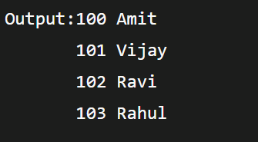
Java TreeMap Example
import java.util.*;
class TreeMap1{
public static void main(String args[]){
TreeMap<Integer,String> map=new TreeMap<Integer,String>();
map.put(100,"Amit");
map.put(102,"Ravi");
map.put(101,"Vijay");
map.put(103,"Rahul");
for(Map.Entry m:map.entrySet()){
System.out.println(m.getKey()+" "+m.getValue());
}
}
}

Slide 21
Iterators
Interface
To iterate over collections of java components entirely one by one
Considered as Universal Cursor
METHODS:
1. boolean hasNext() : Returns true if there are more elements left in the iteration
2. int next() : returns next element in the traversal
3. void remove() : removes only last element traversed

Slide 22
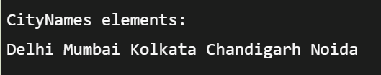
Example of Java Iterator
import java.io.*;
import java.util.*;
public class JavaIteratorExample {
public static void main(String[] args)
{
ArrayList<String> cityNames = new ArrayList<String>();
cityNames.add("Delhi");
cityNames.add("Mumbai");
cityNames.add("Kolkata");
cityNames.add("Chandigarh");
cityNames.add("Noida");
// Iterator to iterate the cityNames
Iterator iterator = cityNames.iterator();
System.out.println("CityNames elements : ");
while (iterator.hasNext())
System.out.print(iterator.next() + " ");
System.out.println();
}
}

Slide 23
Package
Group of similar types of classes, interfaces and sub-packages
Can be categorized in two forms: Built-in package, User-defined package
Advantages:
1. Used to categorize classes & interfaces so that they can easily maintained
2.provides access protection
3. Removes naming collision
Package inside package is called subpackage
If you import a package, subpackages will not be imported.

Slide 24
Import :
To use the Java packages in our programs, import keyword is used.
Example: package myPack;
public class ABC{
        public static void main(String args[]){
        System.out.println(“Welcome”);}
Import myPack.*;

Slide 25
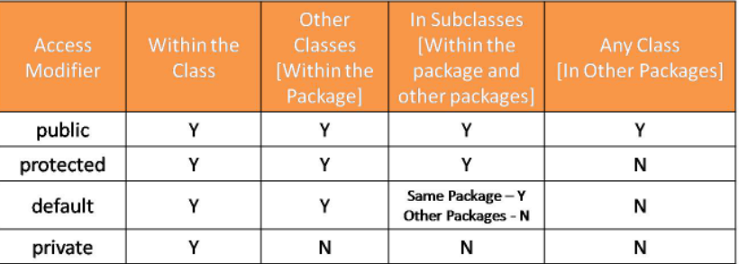
Classpath:
Parameter that specifies the location of user defined classes and packages.
Can be set either on cmd line or through Environment variable
ACCESS CONTROL:
To restrict access of certain members of class to specific parts of program
Done using access modifiers:

Slide 26
QnA

