Slide 1
Multithreading & Networking
- Sayali B

Slide 2
Multi-threading
A thread is a lightweight sub-process
Multithreading is a process of executing multiple threads simultaneously
Threads use shared memory area
Faster context switching
Java provides thread class to achieve thread programming
Advantages of Java Multithreading
1) It doesn't block the user because threads are independent and you can perform multiple operations at the same time.
2) You can perform many operations together, so it saves time.
3) Threads are independent, so it doesn't affect other threads if an exception occurs in a single thread.

Slide 3
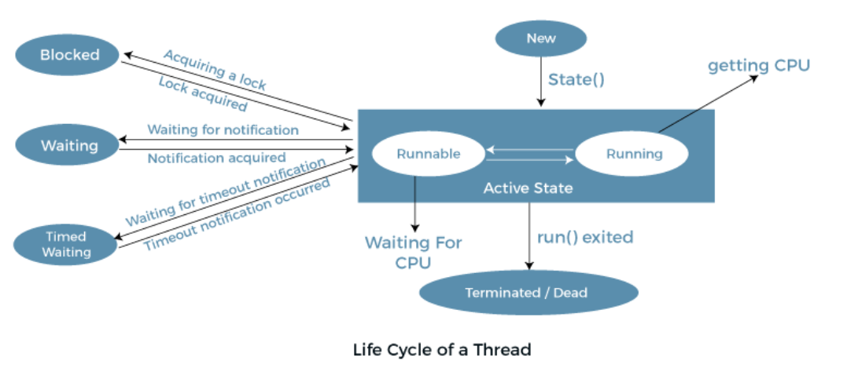
Life cycle of thread
A thread always exists in any one of the following states. These states are:
New
Active
Blocked / Waiting
Timed Waiting
Terminated

Slide 4
There are two ways to create a thread:
By extending Thread class
By implementing Runnable interface.
1.Thread class:
Thread class provide constructors and methods to create and perform operations on a thread.Thread class extends Object class and implements Runnable interface.
Commonly used methods :
public void run(): is used to perform action for a thread.
public void start(): starts the execution of the thread.JVM calls the run() method on the thread.
public void sleep(long miliseconds): Causes the currently executing thread to sleep (temporarily cease execution) for the specified number of milliseconds.
public void join(): waits for a thread to die.
public String getName(): returns the name of the thread.
public void setName(String name): changes the name of the thread.
public boolean isAlive(): tests if the thread is alive.
public void stop(): is used to stop the thread(depricated).

Slide 5
Java Thread Example by extending Thread class
class Multi extends Thread{
public void run(){
System.out.println("thread is running...");
}
public static void main(String args[]){
Multi t1=new Multi();
t1.start();
}
}
Output:
thread is running...

Slide 6
Runnable interface.
The Runnable interface should be implemented by any class whose instances are intended to be executed by a thread.
Runnable interface have only one method named run().
public void run(): is used to perform action for a thread.
Java Thread Example by implementing Runnable interface :
class Multi3 implements Runnable{
public void run(){
System.out.println("thread is running...");
}
public static void main(String args[]){
Multi3 m1=new Multi3();
Thread t1 =new Thread(m1); // Using the constructor Thread(Runnable r)
t1.start();
}
}
Output:
thread is running...

Slide 7
Thread Scheduler :
A component of Java that decides which thread to run or execute and which thread to wait is called a thread scheduler.
If there is more than one thread in the runnable state, it is up to the thread scheduler to pick one of the threads and ignore the other ones.
There are two factors for scheduling a thread i.e. Priority and Time of arrival.
Priority: Priority of each thread lies between 1 to 10. If a thread has a higher priority, it means that thread has got a better chance of getting picked up by the thread scheduler.
MIN-1, NORM -5, MAX -10
Time of Arrival: Suppose two threads of the same priority enter the runnable state, then priority cannot be the factor to pick a thread from these two threads. In such a case, arrival time of thread is considered by the thread scheduler. A thread that arrived first gets the preference over the other threads.

Slide 8
Can we start a thread twice
No. After starting a thread, it can never be started again. If you does so, an IllegalThreadStateException is thrown.
In such case, thread will run once but for second time, it will throw exception.
Ex-
public class TestThreadTwice1 extends Thread{
public void run(){
System.out.println("running...");
}
public static void main(String args[]){
TestThreadTwice1 t1=new TestThreadTwice1();
t1.start();
t1.start();
}
}
Output:
running
Exception in thread "main" java.lang.IllegalThreadStateException

Slide 9
Thread Interruptions:
If any thread is in sleeping or waiting state (i.e. sleep() or wait() is invoked), calling the interrupt() method on the thread, breaks out the sleeping or waiting state
If the thread is not in the sleeping or waiting state, calling the interrupt() method performs normal behaviour and doesn't interrupt the thread but sets the interrupt flag to true.
The 3 methods provided by the Thread class for interrupting a thread
public void interrupt()
public static boolean interrupted()
public boolean isInterrupted()

Slide 10
Example of interrupting a thread that stops working:
class TestInterruptingThread1 extends Thread{
public void run(){
try{
Thread.sleep(1000);
System.out.println("task");
}catch(InterruptedException e){
throw new RuntimeException("Thread interrupted..."+e);
}
}
public static void main(String args[]){
TestInterruptingThread1 t1=new TestInterruptingThread1();
t1.start();
try{
t1.interrupt();
}catch(Exception e){System.out.println("Exception handled "+e);}
}
}
Output:
Exception in thread-0
java.lang.RuntimeException: Thread interrupted...
java.lang.InterruptedException: sleep interrupted
at A.run(A.java:7)

Slide 11
Synchronization in Java
Synchronization in Java is the capability to control the access of multiple threads to any shared resource.
Java Synchronization is better option where we want to allow only one thread to access the shared resource.
The synchronization is mainly used to
To prevent thread interference.
To prevent consistency problem.
If you declare any method as synchronized, it is known as synchronized method.
Synchronized method is used to lock an object for any shared resource.
When a thread invokes a synchronized method, it automatically acquires the lock for that object and releases it when the thread completes its task.

Slide 12
//example of java synchronized method
class Table{
synchronized void printTable(int n){//synchronized method
for(int i=1;i<=5;i++){
System.out.println(n*i);
try{
Thread.sleep(400);
}catch(Exception e){System.out.println(e);}
} } }
class MyThread1 extends Thread{
Table t;
MyThread1(Table t){
this.t=t;
}
public void run(){
t.printTable(5);
}

Slide 13
Network Programming
Java Networking is a concept of connecting two or more computing devices together so that we can share resources
Java socket programming provides facility to share data between different computing devices.
The java.net package supports two protocols,
TCP: Transmission Control Protocol provides reliable communication
UDP: User Datagram Protocol provides a connection-less protocol
Networking terminologies:
IP address
Protocol
Port number
MAC Address
Connection oriented & Connection less
Socket

Slide 14
InetAddress class
represents an IP address.
4 methods:
Method | Description
public static InetAddress getByName(String host) throws UnknownHostException | It returns the instance of InetAddress containing LocalHost IP and name.
public static InetAddress getLocalHost() throws UnknownHostException | It returns the instance of InetAdddress containing local host name and address.
public String getHostName() | It returns the host name of the IP address.
public String getHostAddress() | It returns the IP address in string format.

Slide 15
Example of Java InetAddress Class:
import java.io.*;
import java.net.*;
public class InetDemo{
public static void main(String[] args){
try{
InetAddress ip=InetAddress.getByName("www.javatpoint.com");
System.out.println("Host Name: "+ip.getHostName());
System.out.println("IP Address: "+ip.getHostAddress());
}catch(Exception e){System.out.println(e);}
}
}
Output:
Host Name: www.javatpoint.com
IP Address: 172.67.196.82

Slide 16
Program to demonstrate methods of InetAddress class
import java.net.Inet4Address;
import java.util.Arrays;
import java.net.InetAddress;
public class InetDemo2
{
public static void main(String[] arg) throws Exception
{
InetAddress ip = Inet4Address.getByName("www.javatpoint.com");
InetAddress ip1[] = InetAddress.getAllByName("www.javatpoint.com");
byte addr[]={72, 3, 2, 12};
System.out.println("ip : "+ip);
System.out.print("\nip1 : "+ip1);
InetAddress ip2 = InetAddress.getByAddress(addr);
System.out.print("\nip2 : "+ip2);
System.out.print("\nAddress : " +Arrays.toString(ip.getAddress()));
System.out.print("\nHost Address : " +ip.getHostAddress());
System.out.print("\nisAnyLocalAddress : " +ip.isAnyLocalAddress());
System.out.print("\nisLinkLocalAddress : " +ip.isLinkLocalAddress());
System.out.print("\nisLoopbackAddress : " +ip.isLoopbackAddress());
System.out.print("\nisMCGlobal : " +ip.isMCGlobal());
System.out.print("\nisMCLinkLocal : " +ip.isMCLinkLocal());
System.out.print("\nisMCNodeLocal : " +ip.isMCNodeLocal());
System.out.print("\nisMCOrgLocal : " +ip.isMCOrgLocal());
System.out.print("\nisMCSiteLocal : " +ip.isMCSiteLocal());
System.out.print("\nisMulticastAddress : " +ip.isMulticastAddress());
System.out.print("\nisSiteLocalAddress : " +ip.isSiteLocalAddress());
System.out.print("\nhashCode : " +ip.hashCode());
System.out.print("\n Is ip1 == ip2 : " +ip.equals(ip2));
}
}

Slide 17
Java URL
acronym for Uniform Resource Locator.
It points to a resource on the World Wide Web.
A URL contains many information: ex : https://www.javatpoint.com/java-tutorial
Protocol: In this case, http is the protocol.
Server name or IP Address: In this case, www.javatpoint.com is the server name.
Port Number: It is an optional attribute. If we write http//ww.javatpoint.com:80/abcd/ , 80 is the port number. If port number is not mentioned in the URL, it returns -1.
File Name or directory name: In this case, index.jsp is the file name.
Commonly used methods of Java URL class ::

Slide 18
public String getProtocol() | it returns the protocol of the URL.
public String getHost() | it returns the host name of the URL.
public String getPort() | it returns the Port Number of the URL.
public String getFile() | it returns the file name of the URL.
public String getAuthority() | it returns the authority of the URL.
public String toString() | it returns the string representation of the URL.
public String getQuery() | it returns the query string of the URL.
public String getDefaultPort() | it returns the default port of the URL.
public URLConnection openConnection() | it returns the instance of URLConnection i.e. associated with this URL.
public boolean equals(Object obj) | it compares the URL with the given object.
public Object getContent() | it returns the content of the URL.
public String getRef() | it returns the anchor or reference of the URL.
public URI toURI() | it returns a URI of the URL.

Slide 19
Example of Java URL class
//URLDemo.java
import java.net.*;
public class URLDemo{
public static void main(String[] args){
try{
URL url=new URL("http://www.javatpoint.com/java-tutorial");
System.out.println("Protocol: "+url.getProtocol());
System.out.println("Host Name: "+url.getHost());
System.out.println("Port Number: "+url.getPort());
System.out.println("File Name: "+url.getFile());
}catch(Exception e){System.out.println(e);}
}
}
Output
Protocol: http
Host Name: www.javatpoint.com
Port Number: -1
File Name: /java-tutorial

Slide 20
Socket Progrmming
Used for communication between the applications running on different JRE.
Socket and ServerSocket classes are used for connection-oriented socket programming
DatagramSocket and DatagramPacket classes are used for connection-less socket programming
Socket class can be used to create a socket.
Methods of Socket class:
Method | Description
1) public InputStream getInputStream() | returns the InputStream attached with this socket.
2) public OutputStream getOutputStream() | returns the OutputStream attached with this socket.
3) public synchronized void close() | closes this socket

Slide 21
The ServerSocket class can be used to create a server socket.
This object is used to establish communication with the clients.
Methods:
Method | Description
1) public Socket accept() | returns the socket and establish a connection between server and client.
2) public synchronized void close() | closes the server socket.
Example of Java Socket Programming (Read-Write both side)
In this example, client will write first to the server then server will receive and print the text. Then server will write to the client and client will receive and print the text. The step goes on.

Slide 22
File: MyServer.java
import java.net.*;
import java.io.*;
class MyServer{
public static void main(String args[])throws Exception{
ServerSocket ss=new ServerSocket(3333);
Socket s=ss.accept();
DataInputStream din=new DataInputStream(s.getInputStream());
DataOutputStream dout=new DataOutputStream(s.getOutputStream());
BufferedReader br=new BufferedReader(new InputStreamReader(System.in));
String str="",str2="";
while(!str.equals("stop")){
str=din.readUTF();
System.out.println("client says: "+str);
str2=br.readLine();
dout.writeUTF(str2);
dout.flush();
}
din.close();
s.close();
ss.close();
}}

Slide 23
File: MyClient.java
import java.net.*;
import java.io.*;
class MyClient{
public static void main(String args[])throws Exception{
Socket s=new Socket("localhost",3333);
DataInputStream din=new DataInputStream(s.getInputStream());
DataOutputStream dout=new DataOutputStream(s.getOutputStream());
BufferedReader br=new BufferedReader(new InputStreamReader(System.in));
String str="",str2="";
while(!str.equals("stop")){
str=br.readLine();
dout.writeUTF(str);
dout.flush();
str2=din.readUTF();
System.out.println("Server says: "+str2);
}
dout.close();
s.close();
}}

Slide 24
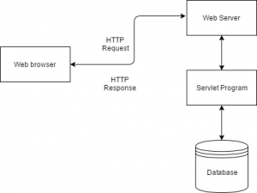
Servlet Programming:
To generate dynamic web pages
Servlets are java programs that run on java-enabled web server or application server

Slide 25
Execution of Servlets basically involves six basic steps:
The clients send the request to the webserver.
The web server receives the request.
The web server passes the request to the corresponding servlet.
The servlet processes the request and generates the response in the form of output.
The servlet sends the response back to the webserver.
The web server sends the response back to the client and the client browser displays it on the screen.
Servlets API’s:
Servlets are build from two packages:
javax.servlet(Basic)
javax.servlet.http(Advance)

Slide 26
Various classes and interfaces present in these packages are:
Component | Type | Package
Servlet | Interface | javax.servlet.*
ServletRequest | Interface | javax.servlet.*
ServletResponse | Interface | javax.servlet.*
GenericServlet | Class | javax.servlet.*
HttpServlet | Class | javax.servlet.http.*
HttpServletRequest | Interface | javax.servlet.http.*
HttpServletResponse | Interface | javax.servlet.http.*
Filter | Interface | javax.servlet.*
ServletConfig | Interface | javax.servlet.*
Various classes and interfaces present in these packages are:

Slide 27
Servlet Example by implementing Servlet interface
File: First.java
import java.io.*;
import javax.servlet.*;
public class First implements Servlet{
ServletConfig config=null;
public void init(ServletConfig config){
this.config=config;
System.out.println("servlet is initialized");
}
public void service(ServletRequest req,ServletResponse res)
throws IOException,ServletException{
res.setContentType("text/html");
PrintWriter out=res.getWriter();
out.print("<html><body>");
out.print("<b>hello simple servlet</b>");
out.print("</body></html>");
}

Slide 28
public void destroy(){System.out.println("servlet is destroyed");}
public ServletConfig getServletConfig(){return config;}
public String getServletInfo(){return "copyright 2007-1010";}
}

